Slide 1

Supervised Learning - theme h
Final Checkpoint

Slide 2

Problem Description
Gliomas are a very common type of brain cancer and can be graded as LGG (Lower-Grade Glioma) or GBM (Glioblastoma Multiforme) depending on clinical and molecular/mutation factors.
The datasets provided are made with the purpose of improving the grading process performance and evaluation costs once molecular tests are too expensive to help accurately diagnose glioma patients.
There are 20 different types of gene mutations and 3 clinical features : race , age at diagnosis and gender.
On this checkpoint we are supposed to do many experiences and explore the data in order to conclude the pre-processing phase . This can be done using (Aggregation,Sampling, Discretization and Binarization,Attribute Transformation ,Dimensionality ReductionFeature subset selection,Feature creation.

Slide 3
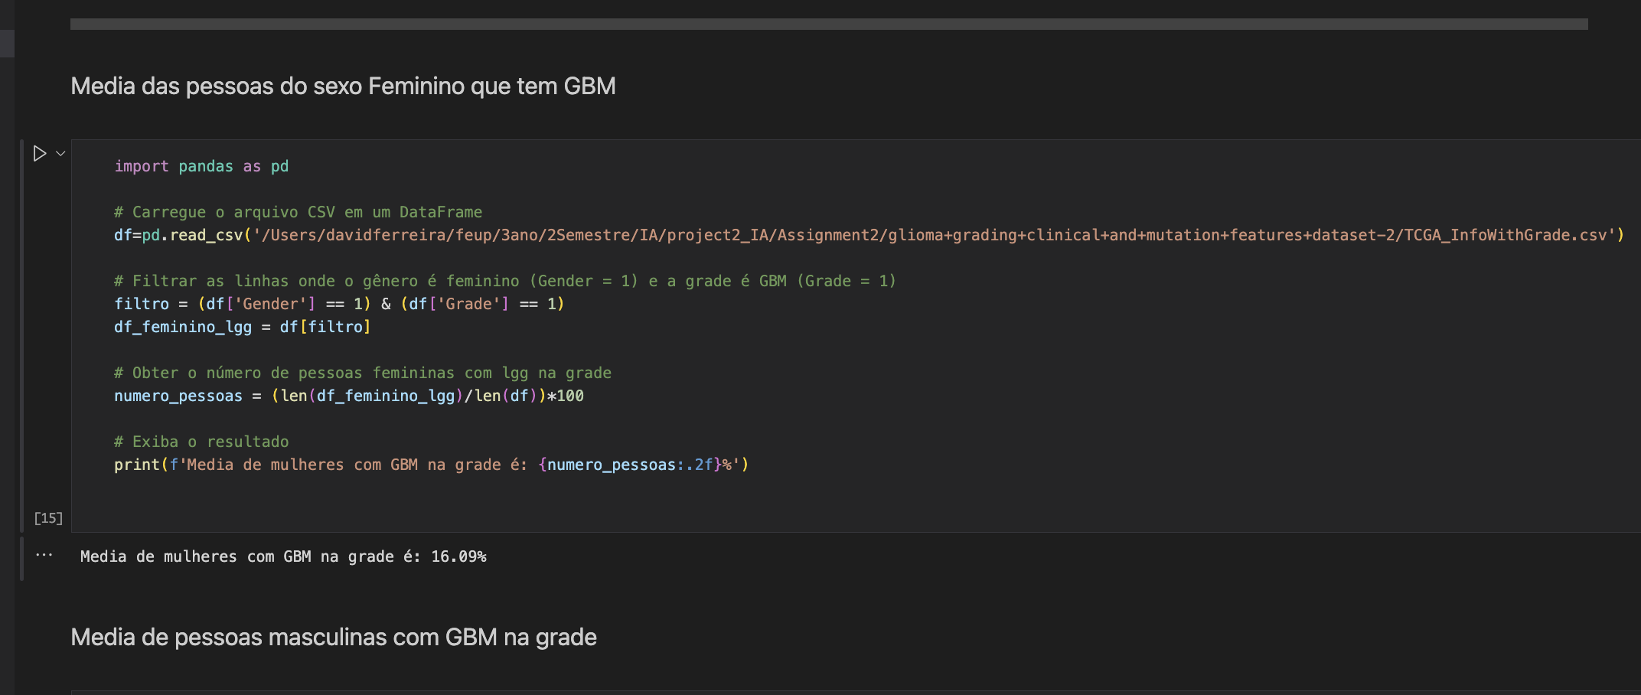
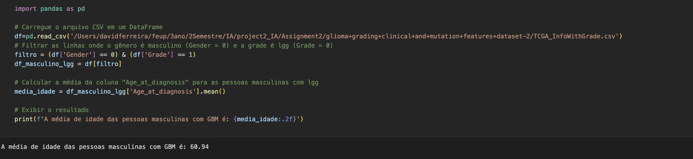
Geral Data
At the beginning of the project we did some initial experiments that could be useful, such as the number of people used in the csv file, or the number of females who have the tumor.

Slide 4
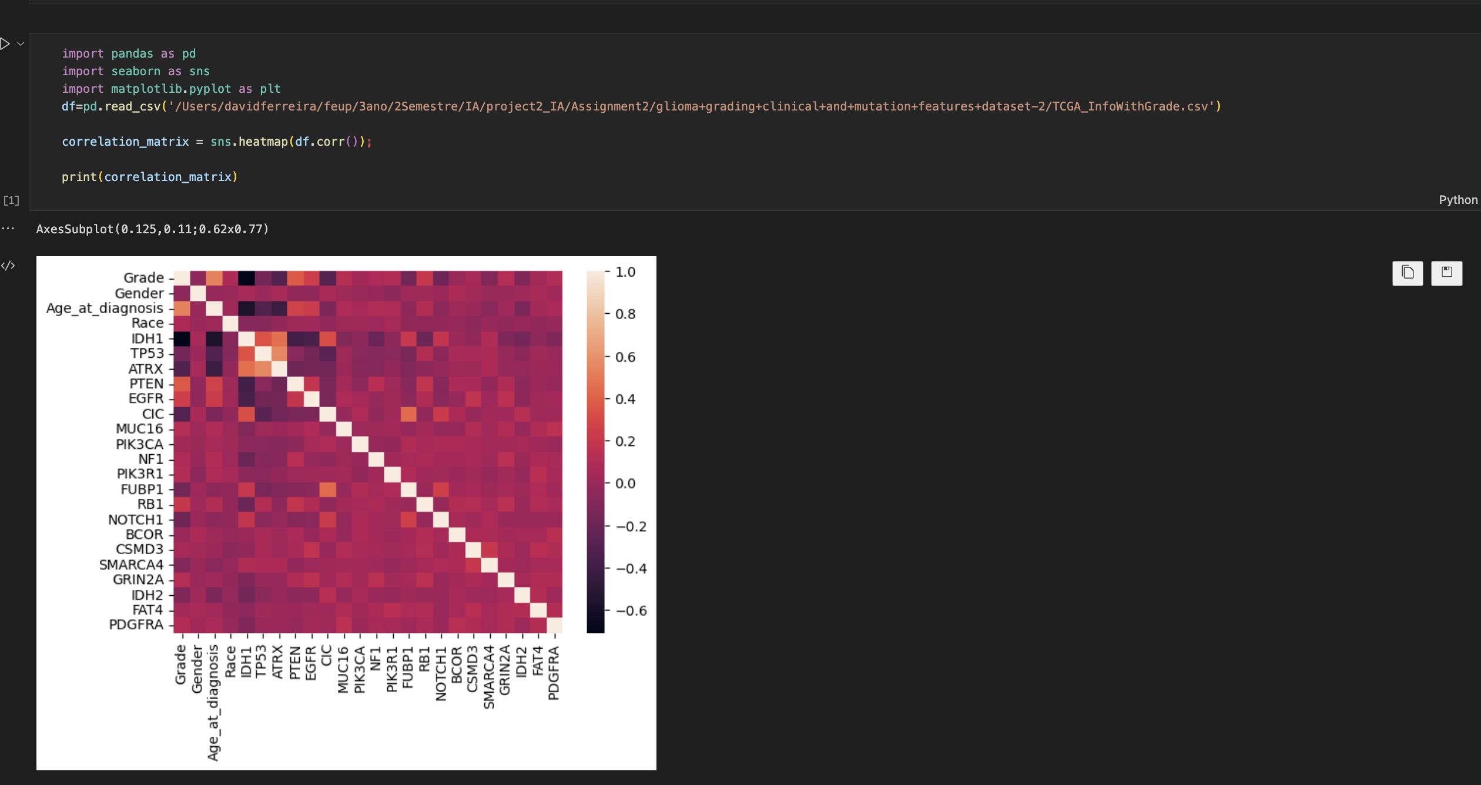
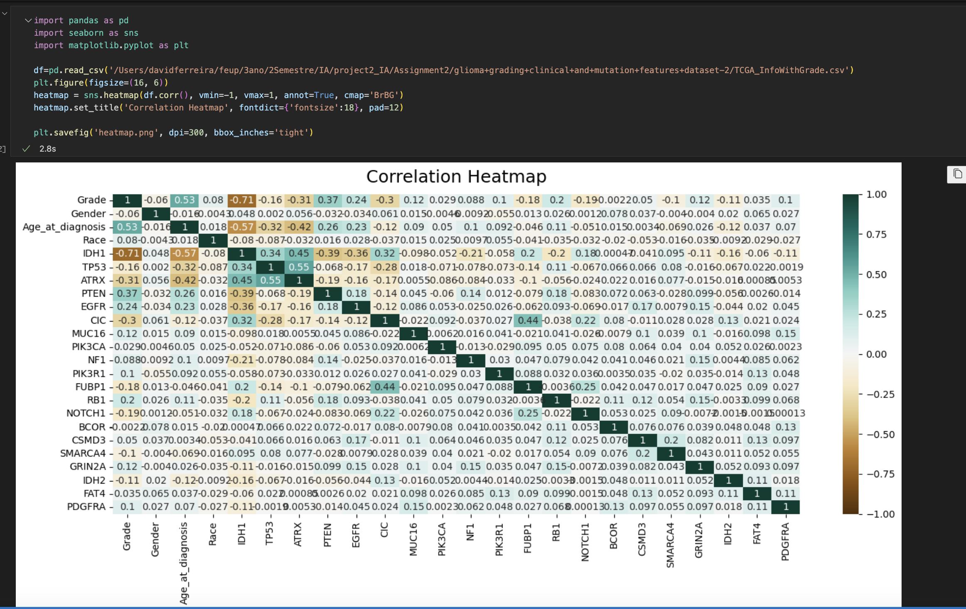
Correlation Matrix
We used correlation matrices to verify if there was any connection between the variables.

Slide 5
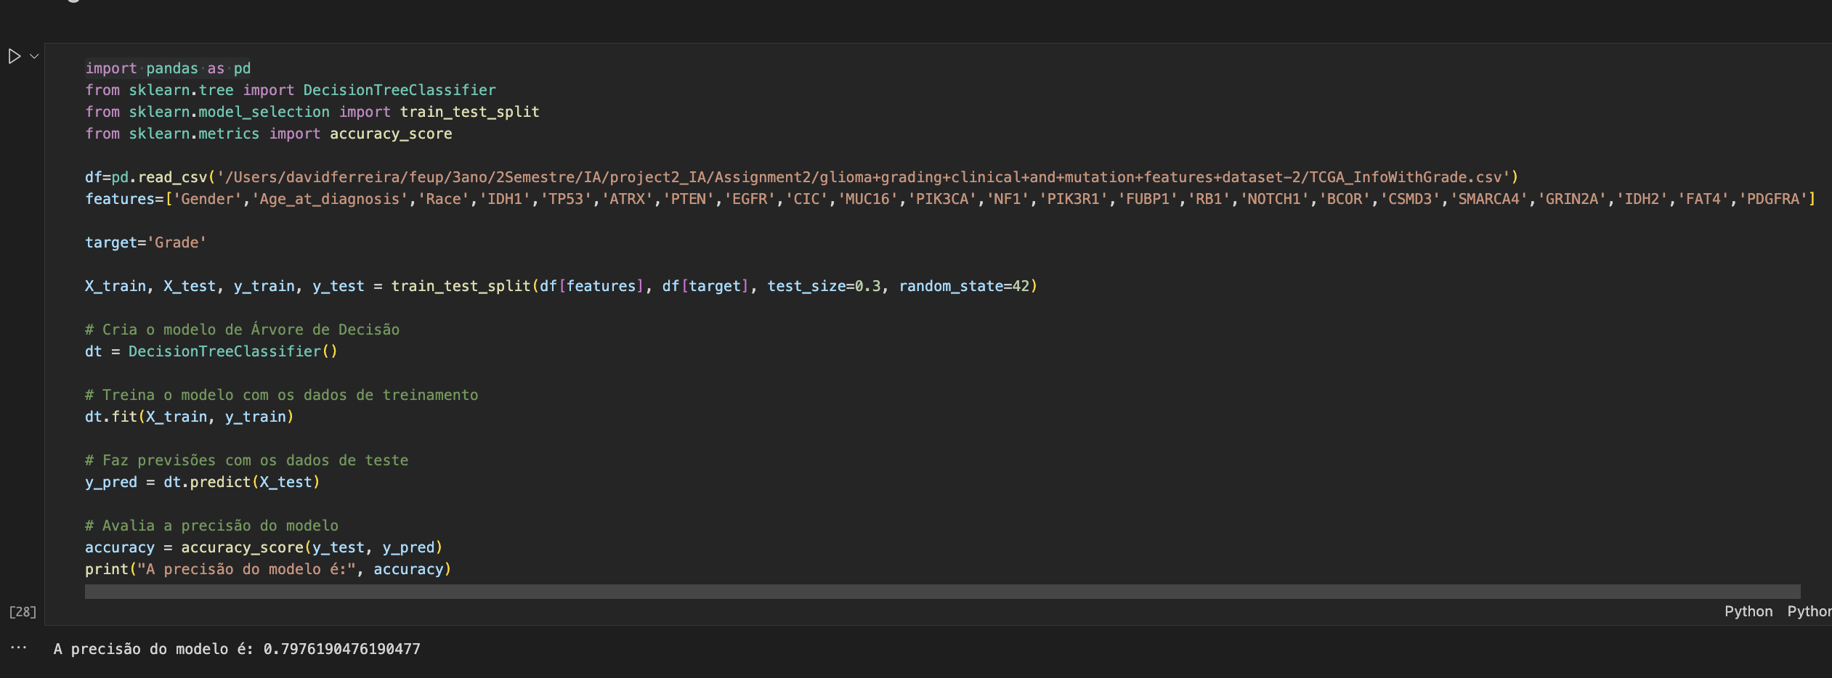
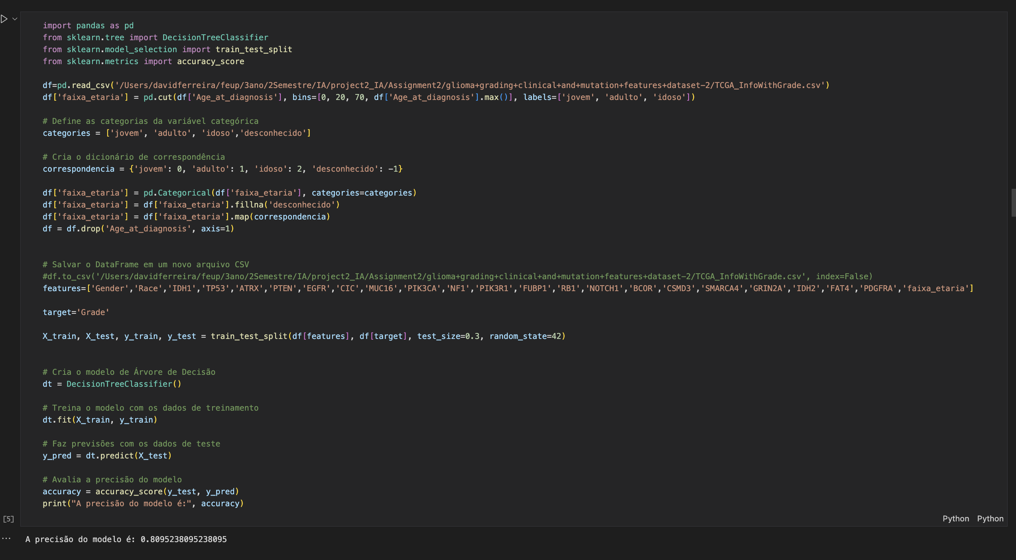
Decision Tree

Slide 6
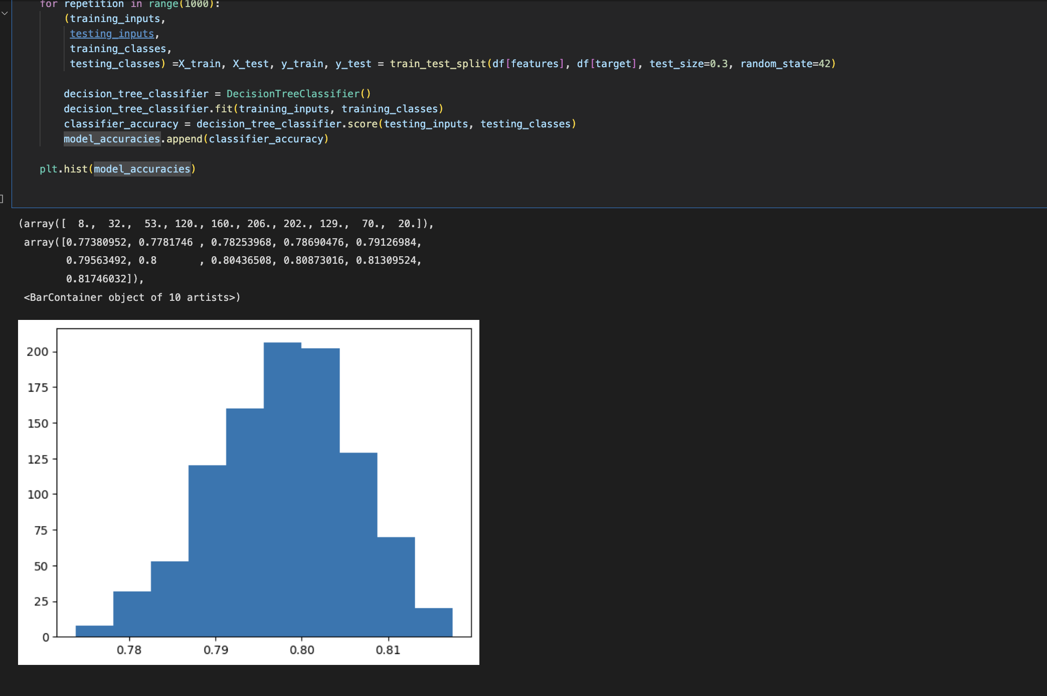
Decision Tree
Accuracy values that may vary in the Decision tree:

Slide 7
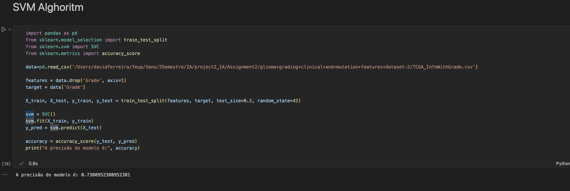
SVM

Slide 8
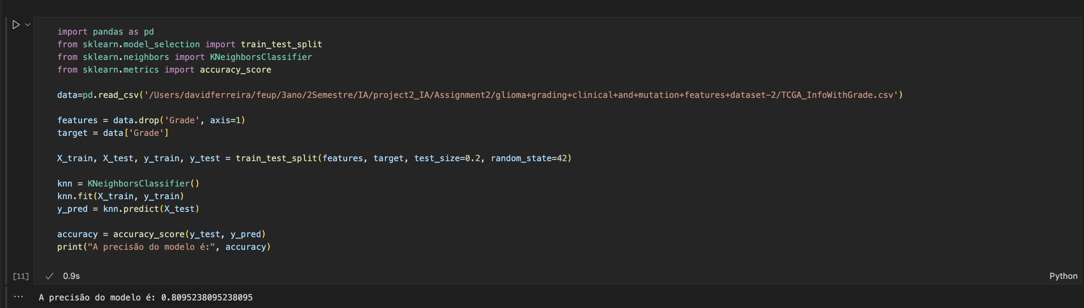
K-NN

